Slide 1

E-Commerce Business Performance & Unit Economics Analysis
End-to-end business analysis using SQL & Power BI to uncover why a high-revenue business remains loss-making and identify critical actions required for sustainable profitability.

Slide 2
BUSINESS BASELINE
Operating at Scale, Not Profitability
837K
₹472Cr
Completed Orders
Net Revenue
Strong transaction volume
Substantial top-line growth
What This Reveals
The business operates at significant scale with confirmed customer demand. High transaction volumes and substantial revenue demonstrate market traction and operational capacity.
Critical Insight: The challenge isn't scale or demand—it's achieving profitability at scale. Revenue growth masks underlying unit economics problems.

Slide 3
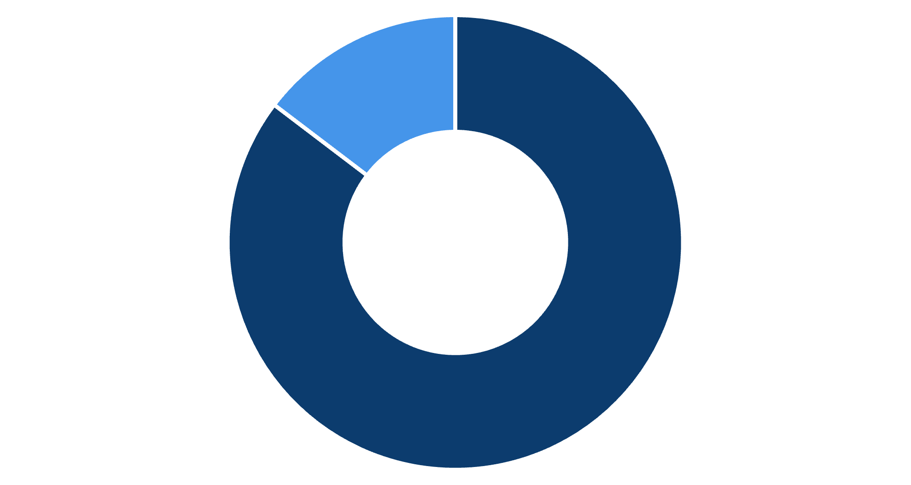

REVENUE COMPOSITION
Repeat Customers Drive 86% of Revenue
Business Risk: Any experience failure directly threatens revenue stability and long-term growth potential.
Repeat Users
New Users
New Users
Repeat Users
121K orders • ₹68.21 Cr revenue
716K orders • ₹403.30 Cr revenue
Acquisition engine functioning
Retention is the real revenue driver

Slide 4



CRITICAL ALERT
Customer Churn Threatens Revenue Stability
27%
Customer Churn Rate
What This Means
A 27% churn rate is significantly elevated for e-commerce, indicating systemic post-order experience problems that erode customer lifetime value.
Revenue Impact
Experience Signal
Losing customers faster than industry benchmarks directly impacts future revenue predictability
High churn correlates with delivery delays, service failures, and unmet expectations

Slide 5

Delivery Delays: A Systemic Operational Failure
Scale of the Problem
Cascading Impact
Majority of orders experience delivery delays—approximately 835K orders affected across the customer base
Poor delivery experience drives high complaint volumes, reduces repeat purchases, and increases costly refunds
Root Cause
Delivery is the single biggest operational failure, not an isolated incident but a structural weakness

Slide 6
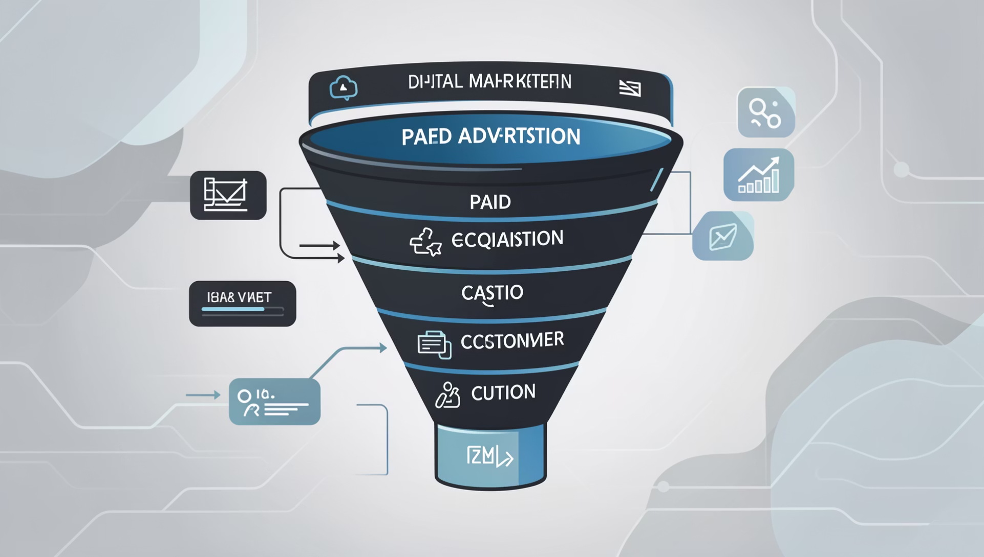


MARKETING EFFICIENCY
Acquisition Volume vs. Quality Trade-off
Channel Performance Analysis
Key Insight: Paid acquisition delivers volume efficiently, but volume alone doesn't guarantee profitability or sustainable unit economics.
Paid Channels
Organic & Referral
~73% of new user acquisition with lowest CAC—efficient for volume generation
Higher CAC with lower acquisition volume—less scalable but potentially higher intent

Slide 7

Customer Lifetime Value: No Channel Advantage
₹15K
Highest Individual CLTV
Peak customer value observed
Channel Parity
Average CLTV remains consistent across all acquisition channels—paid, organic, and referral show no meaningful differentiation in long-term customer quality.
Strategic Implication
No acquisition channel delivers demonstrably higher-quality customers. Marketing spend is optimized for acquisition volume rather than long-term customer value creation.
Opportunity Cost
Resources allocated to volume acquisition could generate higher ROI if redirected toward retention and experience improvement

Slide 8
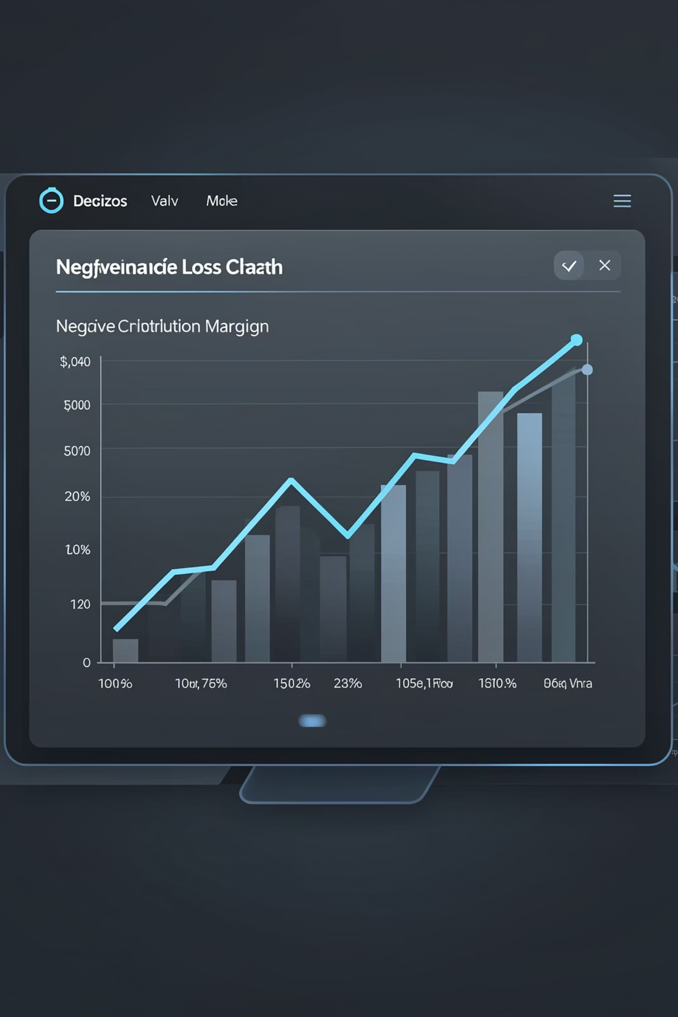
Unit Economics Failure: Scaling Increases Losses
Contribution Margin
Primary Cost Drivers
–₹119.34 Cr Loss
Delivery costs, marketing spend, refunds, and customer compensation erode margins
Core business economics are broken
Growth Paradox
Every incremental order increases total losses—scaling amplifies the problem
This is a unit economics failure, not a growth failure. Without fixing cost structure, expansion accelerates cash burn.

Slide 9
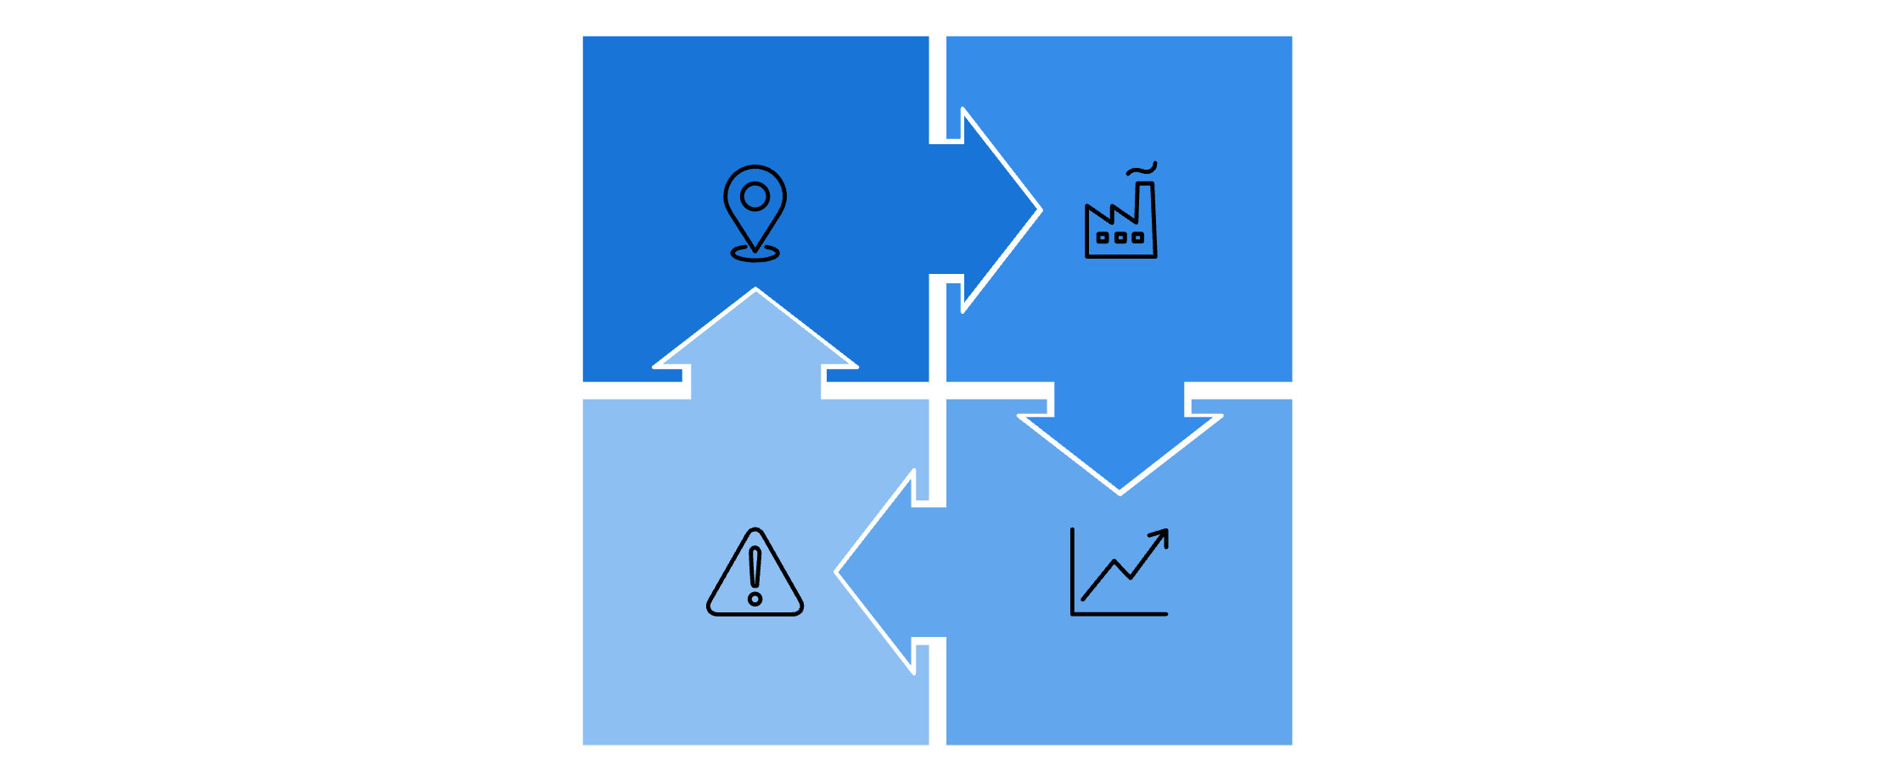

GEOGRAPHIC ANALYSIS
All Cities Loss-Making: Geographic Expansion Risk
Critical Findings
City A: -₹17.45 Cr
City B: -₹8.20 Cr
All 7 operational cities generate losses
Some high-revenue cities produce even higher losses
Highest single-city loss: ₹17.45 Cr
City D: -₹3.10 Cr
City C: -₹5.75 Cr
Strategic Risk: Geographic expansion without fixing unit economics is financially dangerous. New markets amplify systemic cost problems.
Geographic distribution reveals no profitable markets—expansion replicates losses across new territories.

Slide 10
ACTION PLAN
Path to Sustainable Profitability
Immediate (0–3 months)
Strategic (6–12 months)
Fix delivery SLAs in high-loss cities and tighten refund/compensation policies to stop cash leakage
Rebuild unit economics before scaling further—optimize delivery costs and align marketing spend with CLTV, not CAC alone
1
2
3
Short-Term (3–6 months)
Shift focus from acquisition to retention—launch loyalty programs targeting repeat users who drive 86% of revenue
Core Diagnosis: This is an operations and unit economics problem, not a demand, pricing, or marketing scale issue. Profitability requires operational excellence, not just revenue growth.

